Slide 1

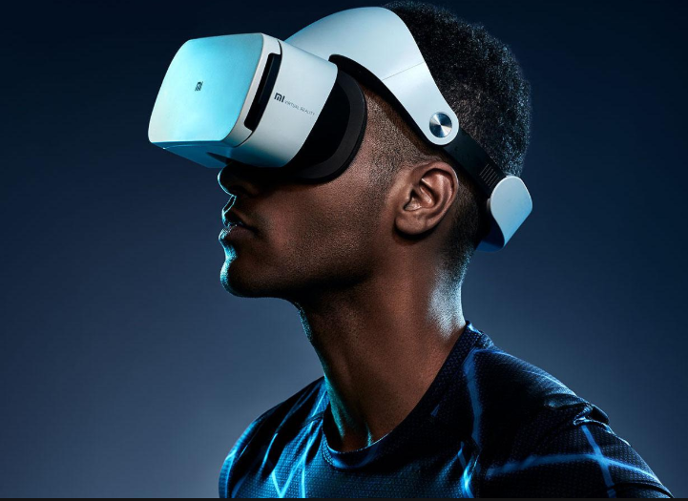
MUSEUM CORVUS
Digital Storytelling on a Virtual Heritage Museum with Believable Agents based on Turkish Horror Folklore
Team Members:
Oğulcan Merdivanlı
Hasan Saygın Dikbayır
Utku Mert Degirmenci
Advisor: Murat YILMAZ, Dr. Instructor
Co-advisor: Ulaş GÜLEÇ, Dr. Lecturer

Slide 2
Objectives of the Study
Definition: Developing a virtual environment to bring back long-forgotten Turkish horror culture.
Designed for every individual who are interested in horror or Turkish folklore.
Compatible for both PC and VR medium.
Main Features
Presenting a museum experience based on Turkish horror culture.
Digital storytelling
Realism with believable agent concept
Constraints
Lack of written sources leads to uncertainty about the folklore.

Slide 3
Objectives of the Study Project provides:
Turkish horror culture in a much more enjoyable and efficient way.
A new approach to storytelling by using believable agents and VR technology.
In a 3D modeled realistic creepy environment, visitors will interact with objects and learn about Turkish horror culture and it’s very unique characters
Scenario and of the game and narration will make it easier to dive into the story and provide memorable horrific experience.
Believable agents will make the ambience more nervous by giving the environment it’s living sentiment .

Slide 4


Stakeholders
Portakal Technology
Software Engineering
Innovation Management
Cloud-Native Software
Secure Development
Virtual and Augmented Reality
Free and Open Source Software
Gerisi Hikaye Team
Gerisi Hikaye is a podcast that is all about horror. Produced and presented by Işın Beril Tetik, Demokan Atasoy and Galip Dursun.
This team has been working together for more than a decade, first started writing stories on (Gölge-Horror and Suspense e-magazine) and then wrote horror stories for Anatolian Horror Stories 1 and 2.

Slide 5
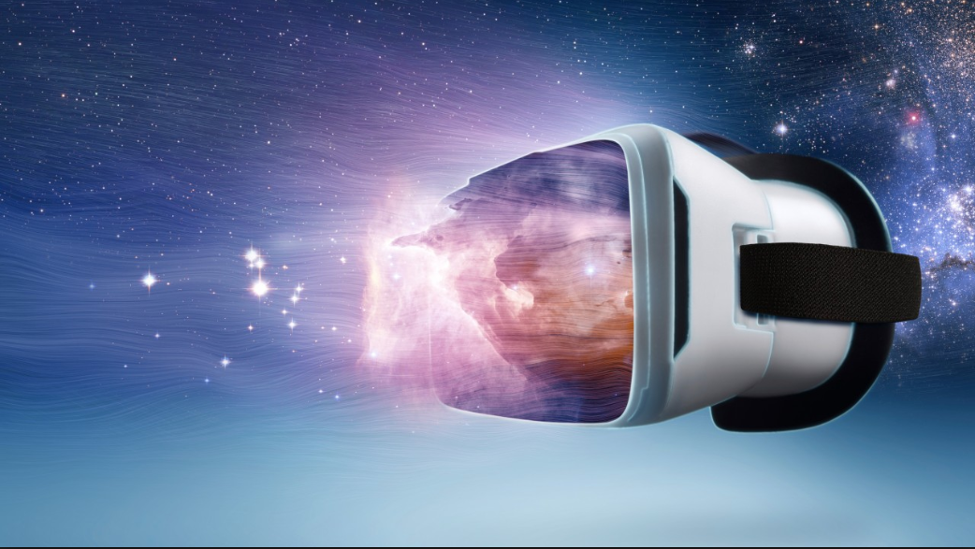
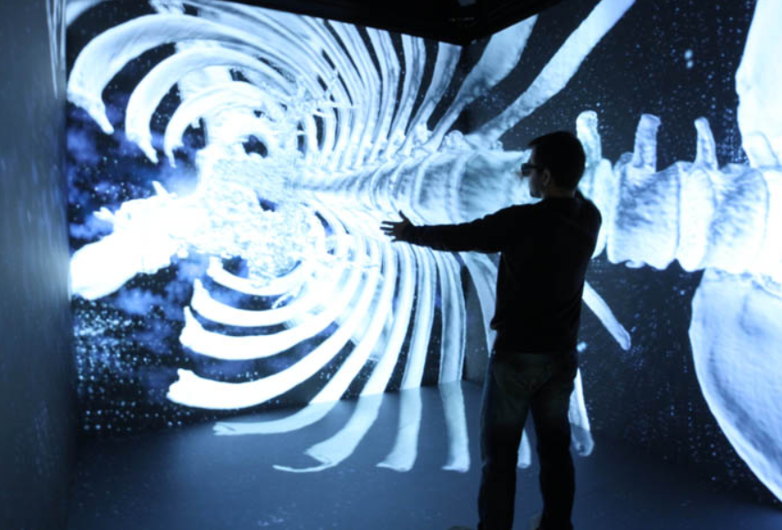
Virtual Reality(VR) What is it ?
General Information
Computer Generated Environment
Provides Occluded and Immersive Experience
Generally Includes Head Mounted Displays, Controllers, Walkable Platform etc.

Slide 6
Basic Objectives Purpose of our Project
Problem
Solution
Cultural heritage that have been forgotten
Hard to gather information through other sources.
Deficiency of storytelling on current sources
Difference of horror factor person to person.
Revive the Turkish horror culture with the museum concept.
Providing accurate and easy to understand information about the culture.
Professional scenario with the help of Gerisi Hikaye Team.
Personal characteristics based story generation.

Slide 7
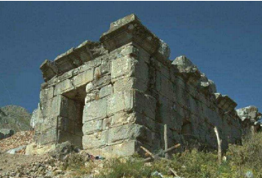
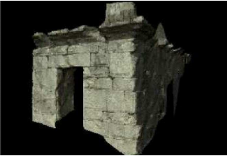
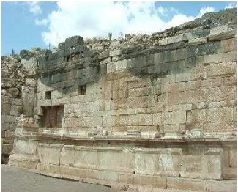
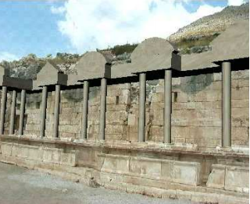
Similar Projects Here is a Project with similar purpose
THE MURALE PROJECT
IMAGE-BASED 3D MODELING FOR ARCHAEOLOGY
Provide tools that archaeologists themselves can use in situ.
Generate 3D models of objects at different scales
Landscapes,
Buildings
Statuary
Pot sherds.

Slide 8
Pros and Cons to Similar Projects
Projects | Sophisticated AI | Storytelling | Cultural Heritage | Narration | Interaction | Based on Real Museum
3d Murale | ✘ | ✘ | ✔ | ✘ | ✔ | ✘
ARCO | ✘ | ✘ | ✔ | ✘ | ✔ | ✔
Virtual Dig | ✘ | ✘ | ✔ | ✘ | ✔ | ✔
Woofbert | ✘ | ✔ | ✔ | ✔ | ✔ | ✔
Museum Corvus | ✔ | ✔ | ✔ | ✔ | ✔ | ✘

Slide 9
Success Criterion
Success Criterion | How to Measure
Immersive storytelling environment | T-test
Feasibility of the overall features | Traceability Matrix
Accurate representation of the creatures | Interview with the Gerisi Hikaye team
Efficieny level of didactic quality | Interview with the playtesters

Slide 10
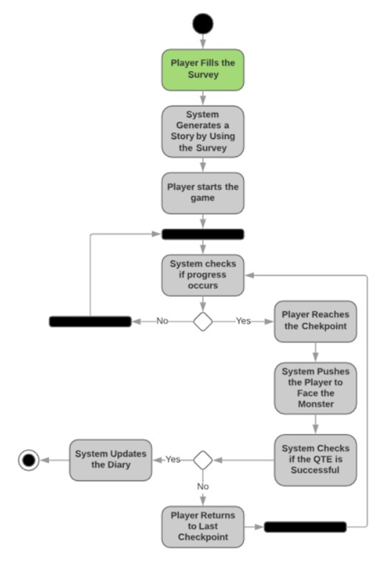
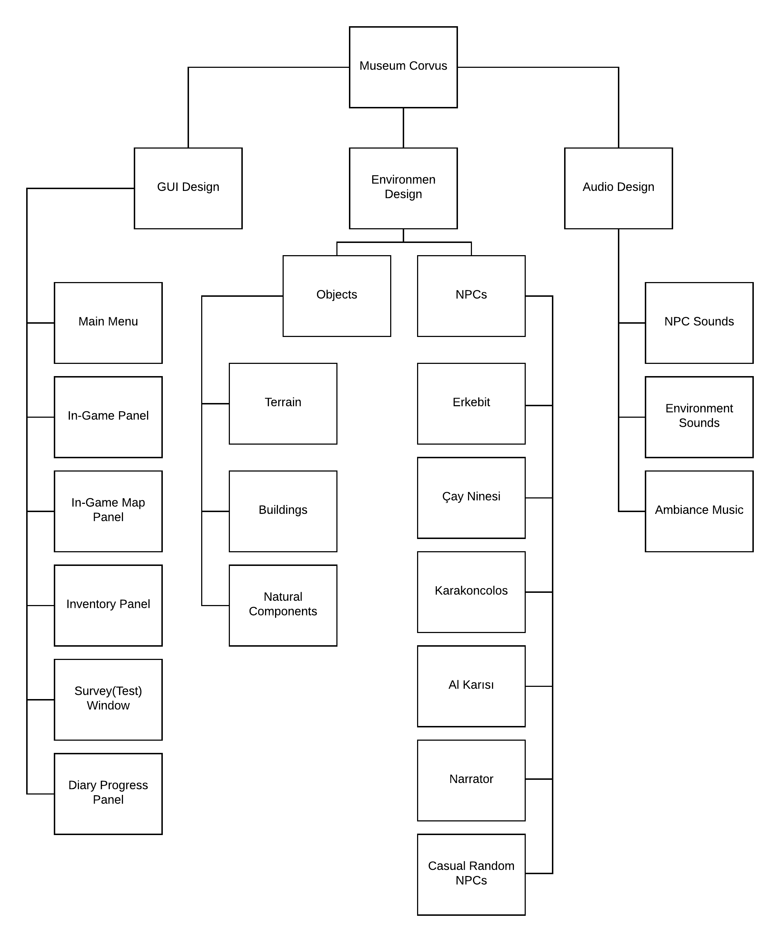
Materials and Methods

Slide 11
Potential Risks
Risks | Potential Impact | Plan B | Importance
Failure of the game mechanism | Inacceptable output | Implementing a feedback functionality to make imrovements | High
Lack of realism | Reduction of immersion | Correcting defects by releasing patches | Medium
Problems about the cultural environment | Incorrect representation of the Turkish motives | Gathering unique assets | Low
Trouble with the story flow | Boredom and loss of relevancy | Meetings with the Gerisi Hikaye team to fix the flow | Medium

Slide 12
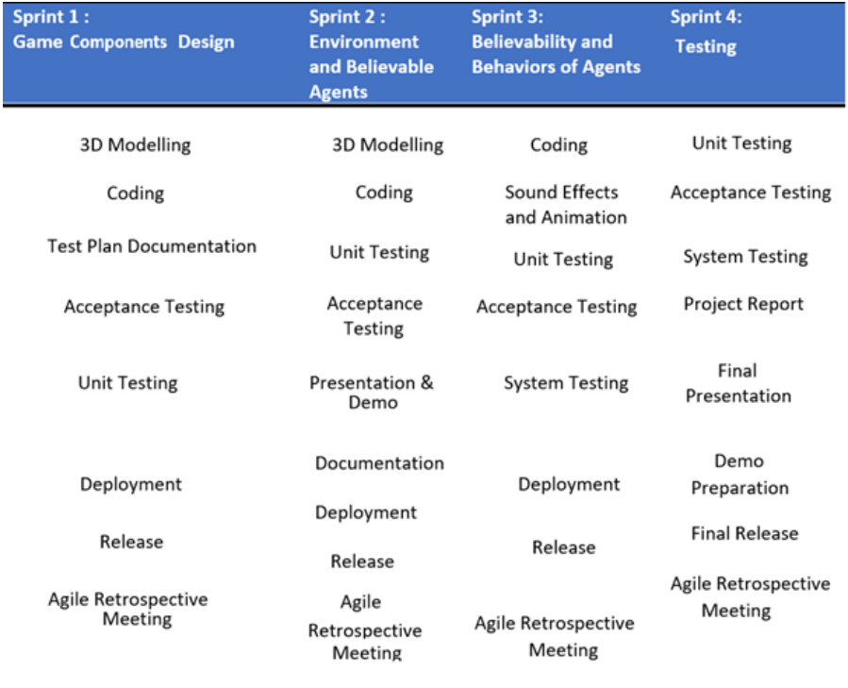
Development Methodology
Development Methodology
Throughout the project, two different methodologies used.
Tentative Project plan for CENG407, the phase of documentation.
Scrum for CENG408, the phase of implementation

Slide 13
Development Methodology
 |  |  | 22.10.2018 28.10.2018 | 29.10.2018-04.11.2018 | 05.11.2018 11.11.2018 | 12.11.2018-18.11.2018 | 19.11.2018-25.11.2018 | 26.11.2018-02.12.2018 | 03.12.2018-09.12.2018 | 10.12.2018-16.12.2018 | 17.12.2018-23.12.2018 | 24.12.2018-30.12.2018
Start Date: 22/010/2018 |  |  | WEEK 1 | WEEK 2 | WEEK3 | WEEK 4 | WEEK 5 | WEEK 6 | WEEK 7 | WEEK 8 | WEEK 9 | WEEK 10
Documentation |  | week(1-5,7-10)
Literature Review | Team
Software Requirements Specification | Team
Software Design Description | Team
Project Report / Project Tracking Form | Team
Project Webpage |  | week(6,10)
Project Webpage design by using XML languages | Team
Testing |  | week(7-10)
Test Data | Team
Reporting | Team
Gantt Chart of CENG407

Slide 14
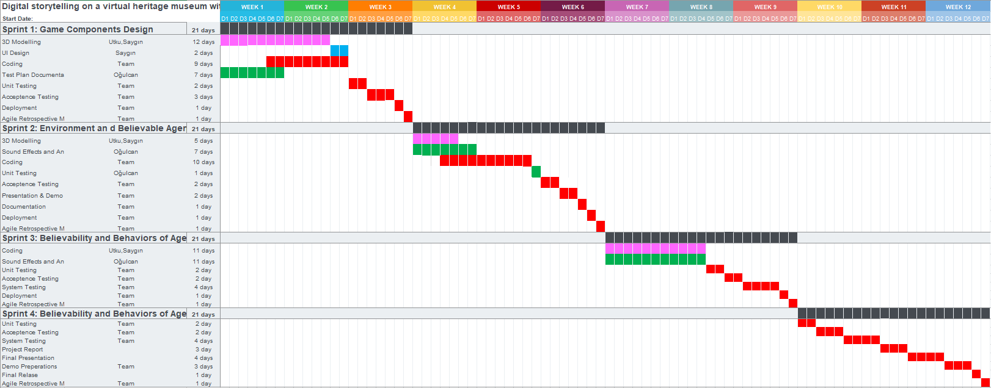
Development Methodology
Gantt Chart of CENG408

Slide 15









Technology Used
Unity 3D Game Engine
Zbrush
Autodesk Maya
Photoshop CC 2018
Illustrator CC 2015
Mixamo Fuse
Visual Studio Community 2017
Ableton Live 9
GitKraken

Slide 16

Tübitak Application
Applied Tübitak Programs
2209-B Sanayiye Yönelik Lisans Araştırma Projelerini Destekleme Programı 2018/6(In-Progress)

Slide 17
Expected Outcomes
WITH THIS PROJECT,
COMBINING two areas that are not combined before which are Virtual Museum concept and Artificial Intelligence.
BRINGING a new approach to cultural heritage with today’s Technologies.
OPENING a new field that may motivate anyone to work topics related with Turkish culture to both raise awareness or spread the culture we own to the World.

Slide 18
Evaluation Future Work
Testing is the one of the most important fact in our project.
T-test will be used for the sake of improvement.
As a measurement, outcomes of t-tests will be placed in a traceability matrix.

Slide 19
Acknowledgement
We are grateful to:
Dr. Instrutor Murat YILMAZ,
Dr. Lecturer Ulaş GÜLEÇ,
Bora GÜNGÖREN,
Gerisi Hikaye Team
Sinan AYYORGUN
Thank you for your guidance and your passion throughout the Project.

Slide 20


ANY QUESTIONS?

